Slide 1
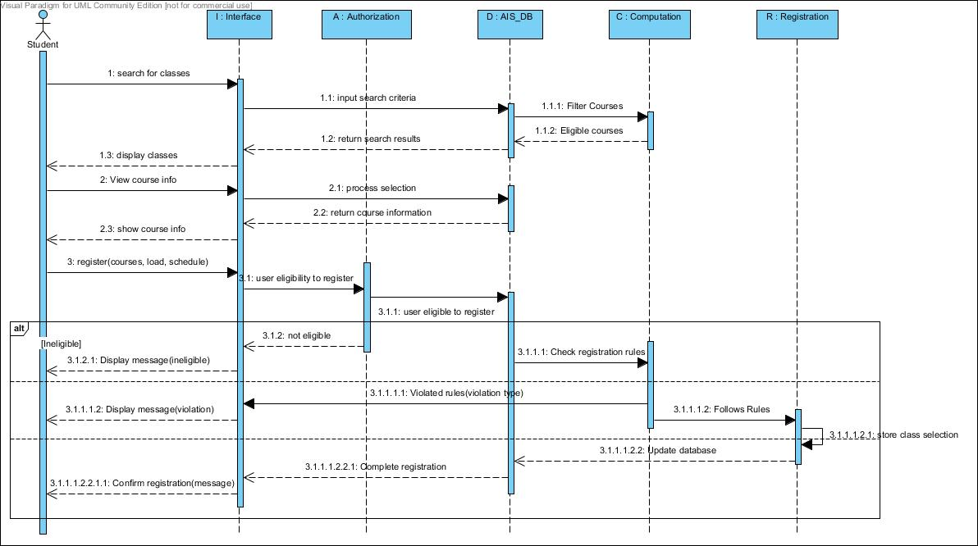
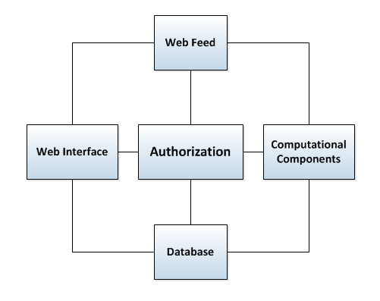
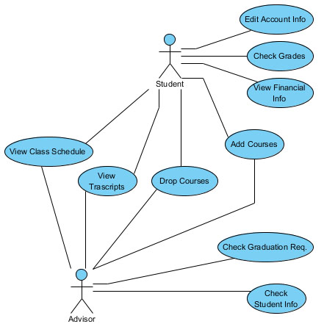
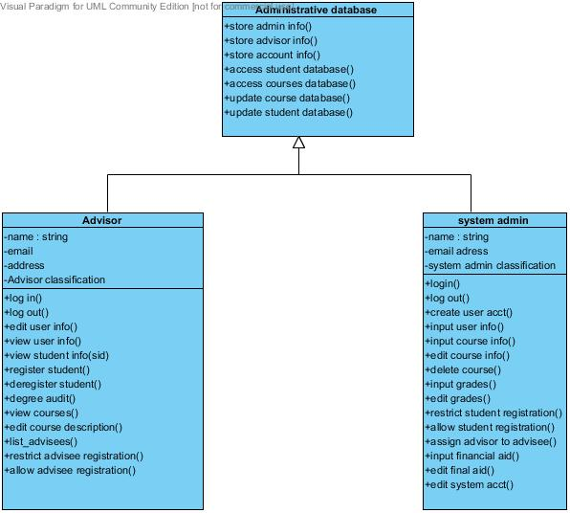
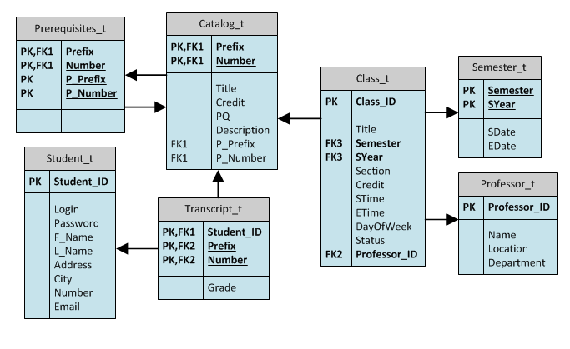
An Automated Registration System
Ryshawn Butler • Joseph Wadner • Alexis Yohe • James Haralambides, PhD
Abstract
Architectural Design for ARS
The system is designed to help students, faculty, and administrators engage in the class registration process in an efficient, streamlined, and method-driven approach. ARS offers recommended registration alternatives based on the academic history and schedule preferences of the student. Students and advisors may fine-tune parameters related to the total number of credits, load balance, and time management (course daily distribution). The system tests requirements including full-time status, maximum credits, scheduling conflicts, and course eligibility (by following prerequisite hierarchies) thus, minimizing administration overhead. The system repository maintains information related to courses as they are listed in the university catalog, student and advisor profiles, class records, and course offerings for upcoming semesters. Student transcripts are produced dynamically to reduce space requirements. In addition to the traditional organization of the transcript (chronological course listing), the system supports customized modular organization of the document. Listed categories include the major, minor, co-requisites, and general education requirements in agreement with information retrieved from the student profile. The latter structure offers a better insight to future student needs and helps produce balanced course schedules.
The main contribution of the system is its capability to offer registration recommendations based on academic history, and student preferences. Course offerings are filtered and eliminated if they: a) do not meet prerequisite requirements, b) they do not belong in the academic plan for the specific individual, c) they have already been taken successfully. Students and advisors may customize results through a menu-driven approach that introduces elements of a balanced course load or schedule (courses are distributed ‘evenly’ among the aforementioned course categories or over the days of the week, respectively).
Figure 1: System Architecture
Figure 3(a) Sequence Diagram: Class Registration.
Figure 1. System architecture
The principal components of the system include the following: a) authorization component, b) web interface, c) web feed, d) database, and e) computational component. The system structure is illustrated in Figure 1.
Figure 3(c) Use Case Diagram
Figure 3(c) Object diagram
Introduction
Figure 3. UML Diagrams for the Automated Registration System
System Functionality
A registration system is a system that provides students, advisors, and administrators the capability to manually search for classes, register for classes, pay tuition, view and update personal information, view and update financial information, etc. Barry University uses a web-based registration system—WebAdvisor—which is a graphical user interface to AIS, the main administrative information system of the university. WebAdvisor’s interface allows the user to navigate through the system in order view information, update information, register for graduation, communicate with advisor, view transcripts, and more. Although WebAdvisor looks simple and easy to use, it has some limitations. These limitations are in the areas of automation, efficiency, rule-based implementation, and feature appeal. Many registration functions are semi-automated to ensure certain registration rules are checked manually beforehand. Student eligibility (financial, health elements) is not yet automated. Registration selections are not checked for integrity nor are they customized to the individual student. More importantly the system operates in passive mode as it does not offer registration recommendations. We propose system modifications that will allow students, advisors, and administration to substantially reduce the in-person process of registration. An Automated Registration System is a system that minimizes computer-human interaction in the following areas: a) student eligibility, b) course eligibility, c) registration recommendations, and d) registration requirement control.
The Automated Registration System (A.R.S.) supplies a web-based registration system for its targeted users that are a part of the Barry University community. A web feed brings current registration information to the system.
The system filters information based on student background information (academic program, prerequisite requirements). The database is, therefore, populated based on course eligibility to increase system performance. Transcript information is organized either chronologically or according to the students major, minor, and elective requirements.
Students registration options are customized with respect to course load balance and course daily distribution. Balanced loads produce schedules where the number of courses in each of the categories of major, minor, or electives is streamlined. Course daily distribution determines the number of class hours the student attends daily on the average. Balancing this parameter leads to evenly distributed class schedules.
The system performs registration control tests to ensure that class registration follows all rules set in the catalog. Such rules include but are not limited to: minimum number of credits (12 credits for full time equivalency requirements), maximum number of credit (18 credits without further approval), minimum passing grade criteria (for course eligibility in cases of retaking a course), scheduling conflicts (overlapping class times), etc. The system is tested for students in the Math and CS department.
Figure 2: E-R Diagram System Database Relationship
Figure 2. E-R diagram for the system database
The authorization component is responsible for user log in and system security against unauthorized access. The web interface component offers users the options to view and more importantly customize registration selections. Getting a web feed is necessary to obtain course listings, transcript information, catalog and registration rules. The database organizes information both statically (catalog) as well as dynamically (course listings, eligible courses, transcripts). The database structure is shown in the entity-relationship diagram of Figure 2. The computational component is the main system controller. It is responsible for the filtering of courses to customized listings, the restructuring of the student transcript, the upholding of registration rules and the compilation of recommended course schedules based on student parameters such as balanced course load or daily distribution. During the developmental stage of the database, software components, relationships, and their dynamic interactions are identified based on the needs of the users. A number of UML (unified modeling language) diagrams help understand system functionality both from a structural or behavioral point of view. Sample diagrams including sequence, use case, and object diagrams and are presented in Figure 3.

