Slide 1
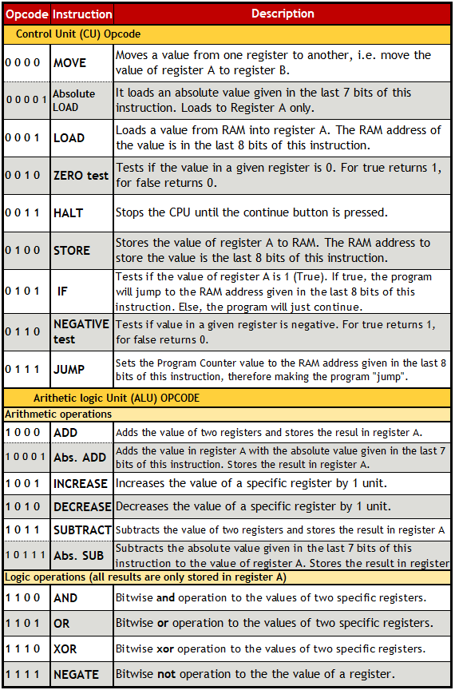
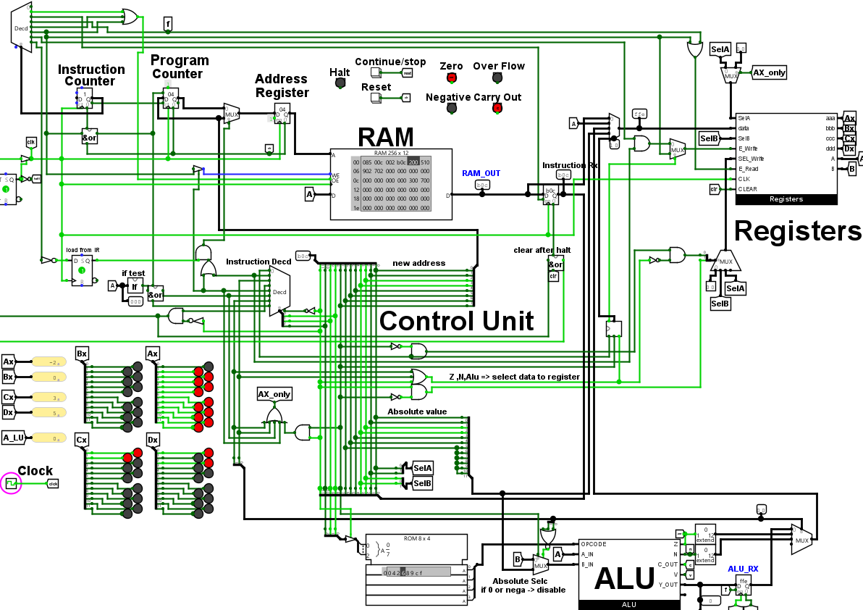
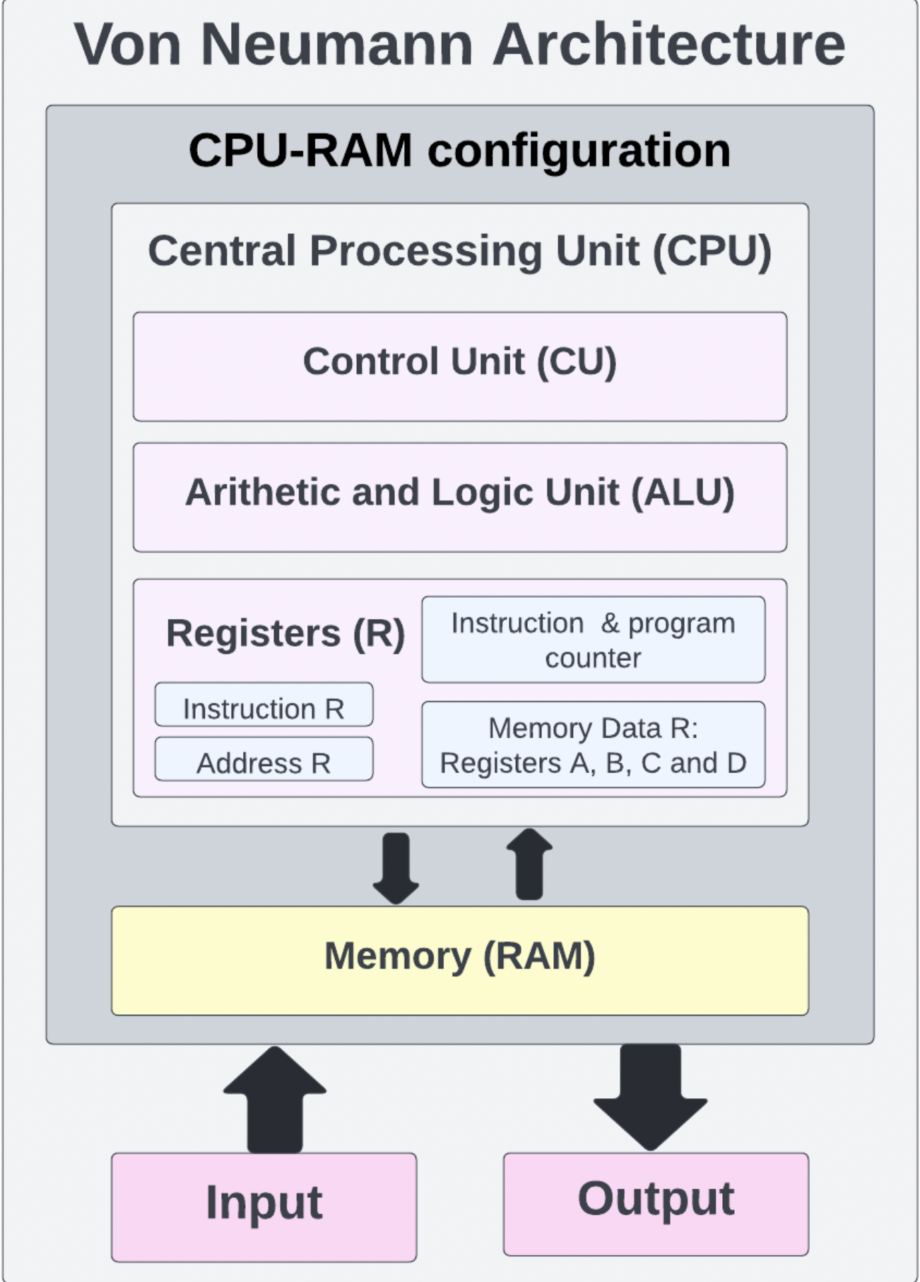
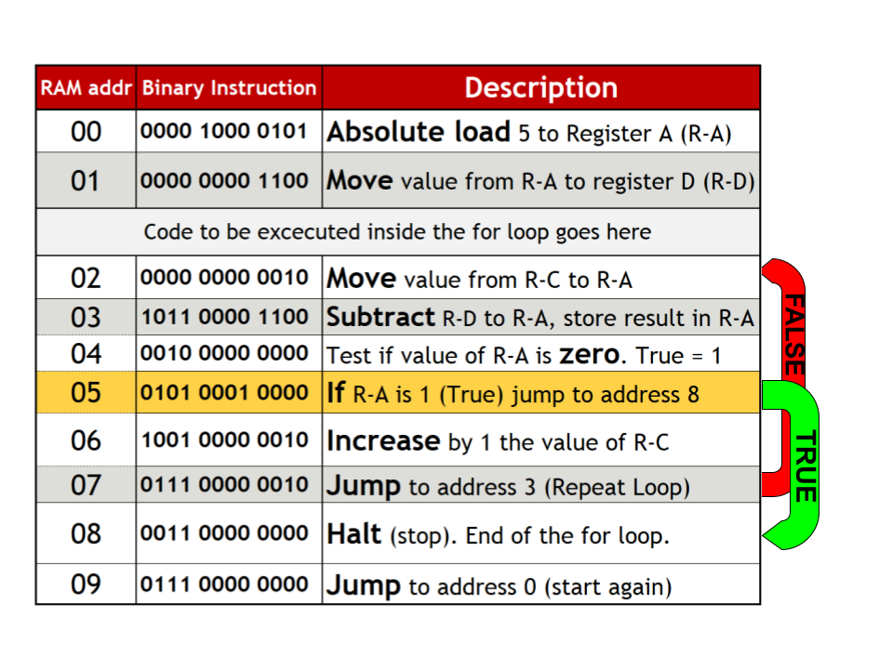
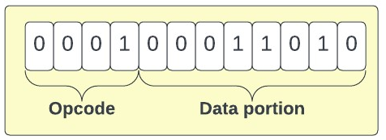
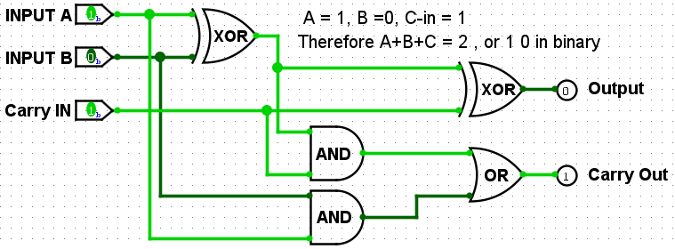
Design Considerations for a Basic CPU-RAM Configuration
Using a Hardwired Control Unit
Department of Mathematics and Computer Science
Barry University
11300 NE 2nd Ave.
Miami Shores, FL 33161
Phone: (305) 899-3035
Abrihana Rivera, Luis Perez, and James Haralambides Ph.D.
Department of Mathematics and Computer Science
Barry University, Miami Shores, Florida 33161
Barry University, Miami Fl
Abstract
CPU – RAM Design
Results
The brain of a computer is the Central Processing Unit (CPU), which is the component whose main function is to execute the instructions of a computer program loaded in memory. The CPU is an electronic circuit designed to perform tasks like logic and arithmetic operations, read and write data to memory, fetch, decode, and execute instructions. We have implemented a simple CPU-RAM configuration with a hardwired control unit through simulation using Logisim-evolution. The computer includes an arithmetic and Logic Unit (ALU), internal registers, a Random-Access Memory (RAM), and circuitry for the implementation of a control unit that supports direct and indirect memory addressing and non-sequential flow of control. The circuit uses 12-bit data values, four bits for Opcode and a 1eight for data. Synchronous counters with asynchronous preset and reset pins are employed in the control unit to run the fetch, decode, and execute phases of the instruction cycle. The number of clock pulses per instruction cycle is determined by the latency of the RAM module which was measured at two pulses for each read or write operation. Assignment, selection, and transfer of control operations are implemented. Memory access is possible with choices of absolute addressing, direct access through memory to register transfers, and indirect access through an added fetch operand phase in the instruction cycle. Further optimization of the control unit may yield reduced execution times for register or memory direct data transfers.
The objective of this design is to run programs given as binary instructions stored in RAM. To achieve this, the CPU fetches (read), decodes (interprets), and executes these instructions in a process that takes 7 clock pulses. This is coordinated by the Instruction Counter (IC), a component that powers up the circuit parts needed to execute a specific instruction as it counts to 7. The timing of these pulses in coordination with the control unit is the key dynamic that allows the CPU to function. After every 7-pulse cycle, the IC increments the Program Counter (PC) value by one. This way, the PC stores the index number of the current instruction, keeping track of where the CPU is located inside the program.
As a design decision, this CPU works with 12-bit data, the 4 most significant bits for the Opcode (fig.6) and the other 8 bits for data. However, as some instructions don't require all the 8 bits for data, we assigned the 5th most significant bit as an absolute flag, dividing some instructions into two: the regular instructions when the 5th bit is 0, and an absolute instruction when it's 1. An example of the latter is adding a fixed number, i.e. 5, directly to register A. This offers a significant efficiency improvement. Also, since 4 bits only have 16 combinations, the opcode was limited to 16 instructions. Adding the absolute flag allows surpassing this barrier.
To understand how these instructions can be useful let's run a for loop.
Introduction
This design is a CPU-RAM configuration that can execute 19 instructions such as add and store. As a conceptual base for the CPU, we used the Von Neumann architecture (fig.1). This means that RAM stores both Instructions and Data values. In this configuration the CPU is guided by the control unit, which behaves as the conductor of the circuit, working together with the registers and the ALU to fetch, decode and execute the instructions stored in RAM. Let's go through the components of the design:
-The Arithmetic and Logic Unit (ALU) performs the computer's arithmetic and logic operations such as and, or, addition and subtraction. It also evaluates if the value of a register is zero or negative. The output from the ALU is only stored in register A.
Fig. 6 Table of Instructions
A for loop runs code a predefined number of times n. The program keeps a count c of the iterations. After each cycle, the program asks: is c equal to n? If true the loop is done, otherwise it updates c and repeats. In this example (fig.7) n is Register D (R-D) and c is register C (R-C). First, the program adds a value n to R-D, then moves R-C to R-A and subtracts R-A from R-D, storing the result in R-A. Then, the program performs a zero test on R-A. if true it will write a 1 in R-A, else a 0. The program asks if R-A is 1 (True); it jumps to address 08. That halts the program. Otherwise, it increments R-C and goes to address 02, to continue performing the for loop.
Fig.4 CPU-RAM configuration (Main Circuit)
Fig.1 Von Neumann architecture
To understand how this configuration works, let’s go through each of the 7 phases for a LOAD instruction and explain what the design is doing:
- Pulse 1: the PC transfers its value to the Address Register (AR), which indicates the address value of the data cell that we want to access in RAM. This is the beginning of the fetch phase.
- Pulse 2: in this pulse, the instruction is retrieved from RAM.
- Pulse 3: the data from RAM is temporarily stored in the Instruction Register (IR). With this, the fetch phase finishes and the decode stage starts. Then, the instruction from the IR is divided into Operational Code (Opcode) and data(fig.5). The logic design implemented in the Control Unit (CU) decodes the Opcode and facilitates a specific logic path in the circuit for the instruction to flow and get executed.
All the instructions share the same steps up to pulse 3, from this point forward each instruction has a different execution.
- Pulse 4: Start of the execution phase. Since the data portion of a LOAD instruction is the RAM address of the value to be loaded, in this pulse the address value from the IR to the address register, so the RAM will update and point to the new cell address desired.
-Registers are basic volatile memory units accessible for the CPU's immediate use. The CPU utilizes many task-specific registers to function, like the address register, which holds the address of the RAM cell the CPU is accessing . Another type is shift registers, such as register A (R-A), implemented for temporary storage and movement of data between registers and the other component of the circuit.
-Random Access Memory (RAM): Memory is achieved through a logic design called a Latch, capable of storing an off (0) or on (1) state. RAM is a matrix of these memory cells that we can read and write in whatever order we want ("random access").
-The Control Unit (CU) is the component of the CPU that interprets the binary instructions. Here the Operational Code (Opcode) is passed through a logic design that outputs the specific combination required to execute the instruction.
This circuit was created using almost exclusively Logic Gates. Therefore, all the operations the circuit can perform were designed from a logic level. Logic gates are small units that perform a Boolean operation that outputs a 1 or a 0 depending on the combination of the input, for two binary inputs A and B (fig.2).
Fig.7 For Loop Instructions
Conclusions
Altogether, what makes this design powerful is how such a complex system can be derived from a set of simple premises like and, or, true, and false. Is the many levels of abstraction that allow these fundamental operations to run a program. More mechanisms could be created on top of this design to run code, like the for loop previously explained. With enough dedication, the set of instructions available is enough to run a simple program.
A full adder (fig.3) is an example of how these logic gates can be used to perform operations. As seen in the image, the way the gates are arranged allow to add two values and a carry in.
- Pulse 5: in this stage, the value to be loaded is retrieved from RAM.
- Pulse 6: in this pulse, the Instruction Counter enables the write mode of the Registers
- Pulse 7: Finally, the value retrieved from RAM is stored in Register A. The instruction is done.
Future Work
Due to the adoption of the 5th most significant bit as an absolute flag, increase and decrease instructions are not needed, since they perform absolute 1 addition and subtraction. This enables the option to change increase and decrease for two new instructions. In addition, some instructions are executed before the 7th pulse, so there's room to improve this by adapting the number of pulses in a cycle to the specific instruction.
Fig.5 Instruction in binary
References
At the end of the cycle, the IC increases the Program Counter by one, so in the next instruction cycle the updated value of the PC will be transferred to the address register, moving forward the pointer to the next RAM address. This way the CPU fetches the next instruction and the program keeps running.​
1. Mano, Morris, and Ciletti, Michael. Digital Design, 4th edition, Pearson, 2006.
2. Instrumental Tools, "Logic Gates", "https://instrumentationtools.com/logic-gates/".
Fig.2 Logic Gates Truth Tables source ref.1
Fig.3 Full Adder

