Slide 1
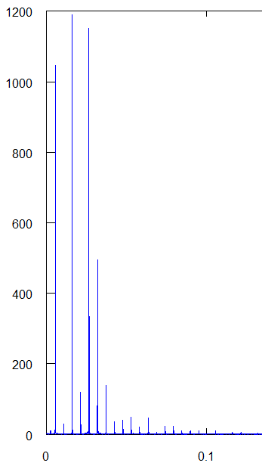
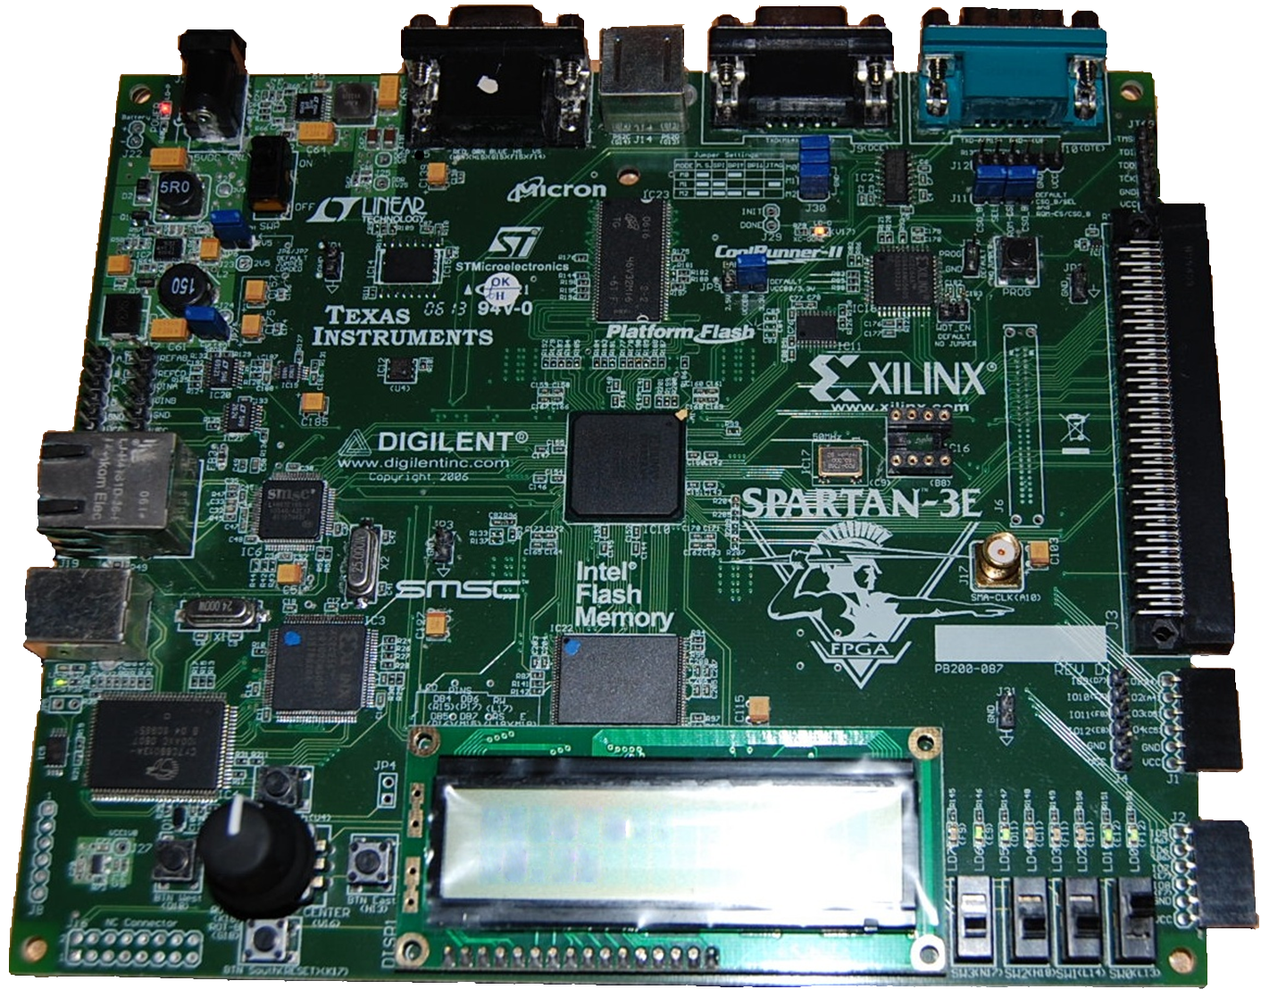
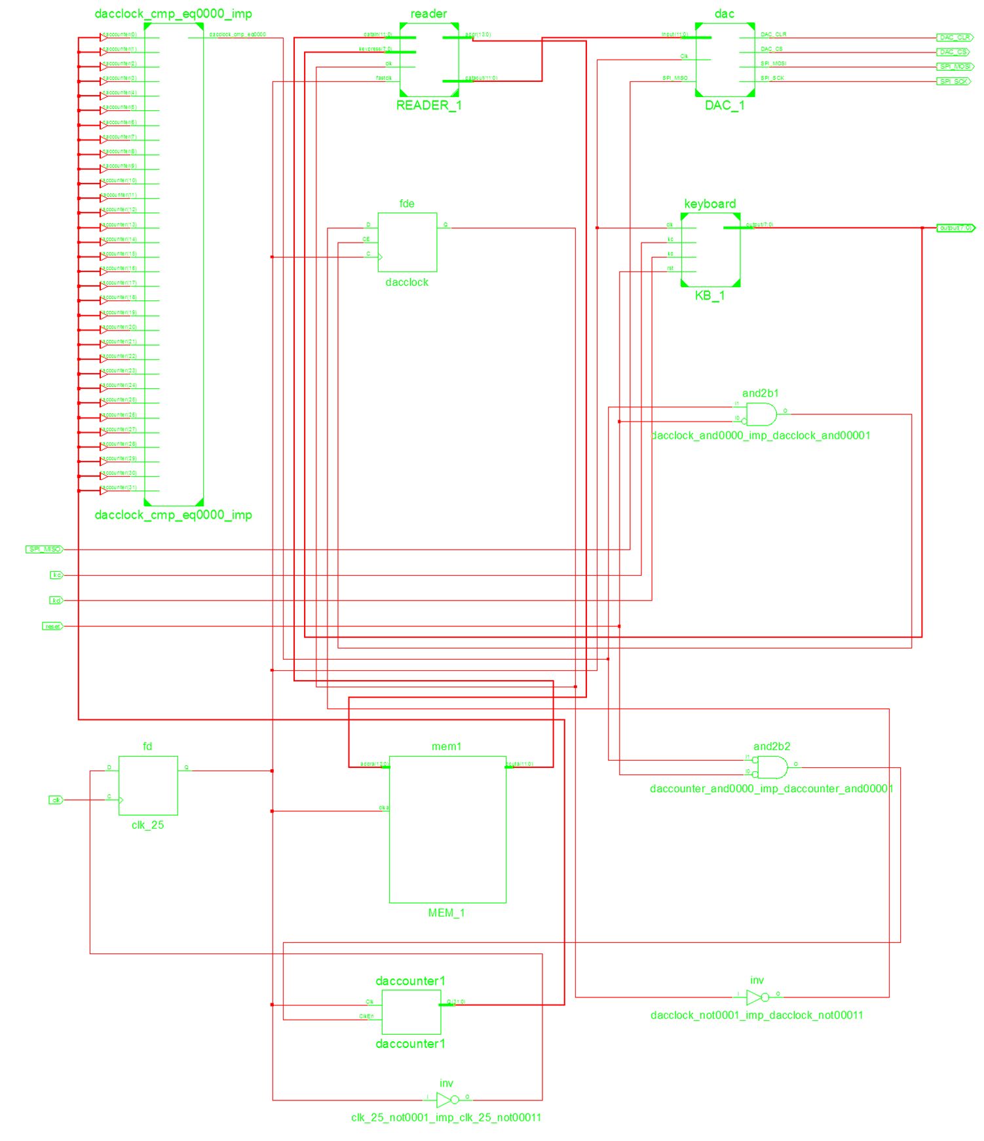
♪
Embedded System Design: Synthesizing Music Using Programmable Logic
George Burri • Khalil Martin • James Haralambides, PhD
Abstract
How it Was Made
Embedded system design is a flexible, yet powerful field in modern computing. An FPGA (Field Programmable Gate Array) used in embedded design consists of a variety of components and interfaces, allowing for a large set of functions and interconnections to be realized. Implementation and testing of designs is supported by Very high-speed integrated circuit Hardware Description Languages (VHDL); FPGAs can be reconfigurable; they can have their firmware programmed to perform a specific task, and then dynamically reprogrammed for a completely separate application. In this project, an FPGA board was programmed as a music synthesizer. The operations performed by the board include taking user input from a keyboard, reading sample data from ROM, digitally synthesizing notes, and converting them to analog sound. In order to faithfully reproduce a musical note, the fundamental frequencies must be determined beforehand. This was accomplished using the software package 'Octave'. A recorded sample of a note being played on an instrument is used as input, allowing the software to create a frequency graph. Spikes in magnitude are recorded, as these correspond to how the note will be digitally represented, and will be stored into an array. The fundamental frequency is also determined from the graph; that is then inputted into a custom visual basic program, that will generate sample data. Once this data has been produced, it is stored into the ROM memory of the FPGA board. Next, the various modules on the board must be programmed to interact with each other. The board reacts to user input from a standard computer keyboard; when a key is pressed, a specific code corresponding to that key is sent to the controller module. The controller must then determine what note to synthesize, if any, depending on the key pressed. To reproduce a note, the fundamental frequencies are read from memory and synthesized by an algorithmic component. The output data stream is sent to the digital to analog converter of the board, to convert the digital data into an analog signal. The note can be heard through the amplifier connected to the board. Though this task is simplistic in purpose and scale, it demonstrates the versatility of programmable hardware and embedded design.
Like any other project, this one began with planning. The task at hand was to create a design that could synthesize music notes. Therefore, the modules that needed to be used were identified. The most obvious was the Digital to Analog Converter (DAC), which must be used to produce any sort of sounds from the device. For input, there were more options available, but the keyboard was a lucrative choice because it naturally lends itself well to music, as well as being fairly simplistic in regards to interface. The most challenging part of the design proved to be the actual synthesis of music notes. Notes can not be arbitrarily created from scratch; synthesis requires sample data measured from a physically played note. This data had to be created on a computer beforehand. A digital recording of a played note was imported into a software package called ‘Octave’. The software analyzed the frequency domain of the sound and
Core Modules
Keyboard Reader
This module represents the sole source of input for the design. Taking a serial input stream from a keyboard connected via the PS/2 interface, this module is responsible for outputting 8-bit ‘key codes’ that indicate what key is being pressed.
ROM (Read Only Memory)
This is where the fundamental frequencies of the notes are stored. The data is stored in it during programming and is read by inputting a memory address.
Memory Reader
This module is responsible for retrieving data from ROM memory and computing the note. It does this by providing the addresses of the harmonics of the note to the memory module. Retrieved data along with corresponding harmonic coefficients are used by the formula to synthesize the note, which is forwarded to the DAC.
Digital to Analog Converter (DAC)
This module is responsible for converting a 12-bit serial data stream into an analog electrical signal. Connecting an amplifier to this module’s pin interface will produce audible sound.
Magnitude
PS/2 Port
>
DAC>
Frequency
Analyzing a Music Note
This graph is a visual representation of a music note in the frequency domain. Each spike indicates a harmonic.
FPGA
♫
Read Only Memory (ROM)
Process overview
This schematic shows the basic modules that compose the design, and the data that flows between them.
Raw
Data
Memory
Address of Data
The FPGA Board
This piece of hardware is actually composed of several smaller hardware components, which are all interconnected. How these components interact is determined by how the FPGA is programmed. The model board used here is a ‘Spartan-3E’, manufactured by Xilinx.
Keyboard Reader
Key code
Memory Reader
Audio Data
Digital to Analog Converter (DAC)
How it Works
produced a graphical representation of the signal in the frequency domain. This graph allowed the fundamental frequency of each note to be easily determined, as each spike of the graph represented a single harmonic of the note. The recorded data was then run through a program and was converted into a 12-bit digital representation suitable for use by the digital-to-analog converter (DAC) on the board. The same data was stored into the ROM module using the core generator provided by the Xilinx Development Software. After the data was accounted for, the actual synthesizing algorithm had to be implemented. The formula used to synthesize the note is: ΣA∙cos(2π∙f(n)), where A denotes the amplitude of the harmonic, and f(n) its frequency. This function was implemented as part of the memory reader module. The final issue that had to be addressed was synchronization; memory is read in parallel, but the DAC takes input in serial. Therefore, the memory reader produces data at a faster rate than the DAC can accept it. Therefore, it was necessary to use a clock divider on the memory module, such that it operates at a slower rate at which in can produce data at the same rate as the DAC can receive it.
The process begins when a key is pressed on the keyboard. The keyboard reader extracts an 8-bit key code, which it then passes to the memory reader. The memory reader matches the key to one of the notes and sends the address of where the fundamental frequencies are stored in memory. The memory receives the address, and passes the frequency data at that location back to the memory reader. The memory reader uses this data in the ΣA∙cos(2π∙f(n)) formula to synthesize the note. This data is then passed to the Digital to Analog converter as an 12-bit serial stream. The DAC takes the data, computes a fractional coefficient and multiplies this by the voltage of the output audio ports, creating a normalized analog signal. The signal is then passed to the connected amplifier, which produces an audible sound.
Interconnections
This diagram illustrates how each component is connected to produce the music synthesizer. But no wires were ever touched! All these “connections” are made by programming the board using VHDL.

