Slide 1
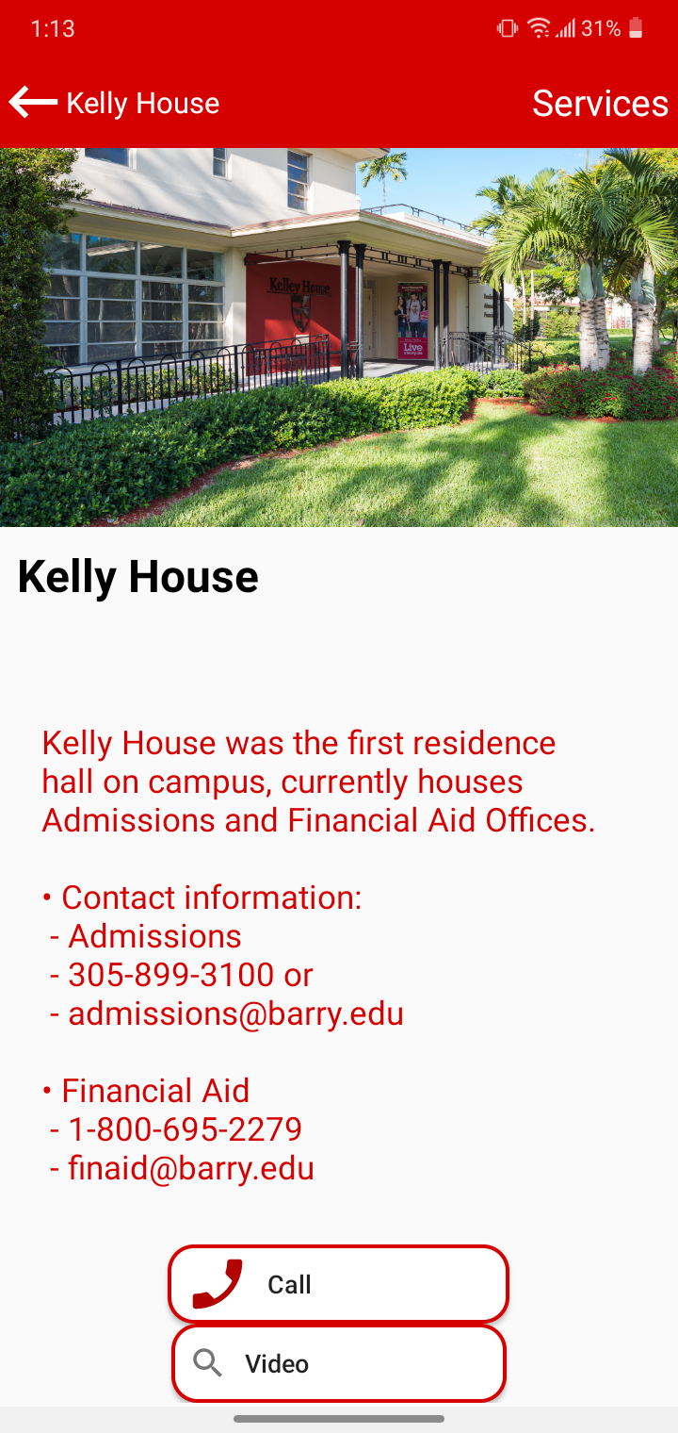
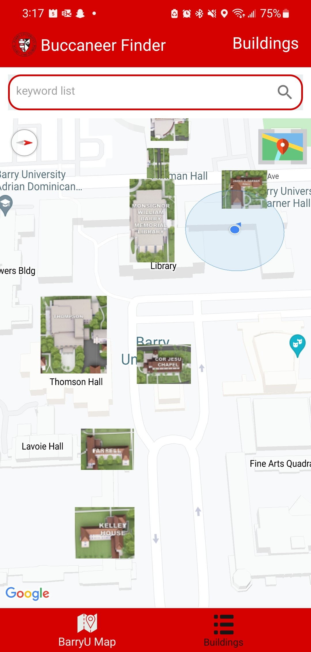
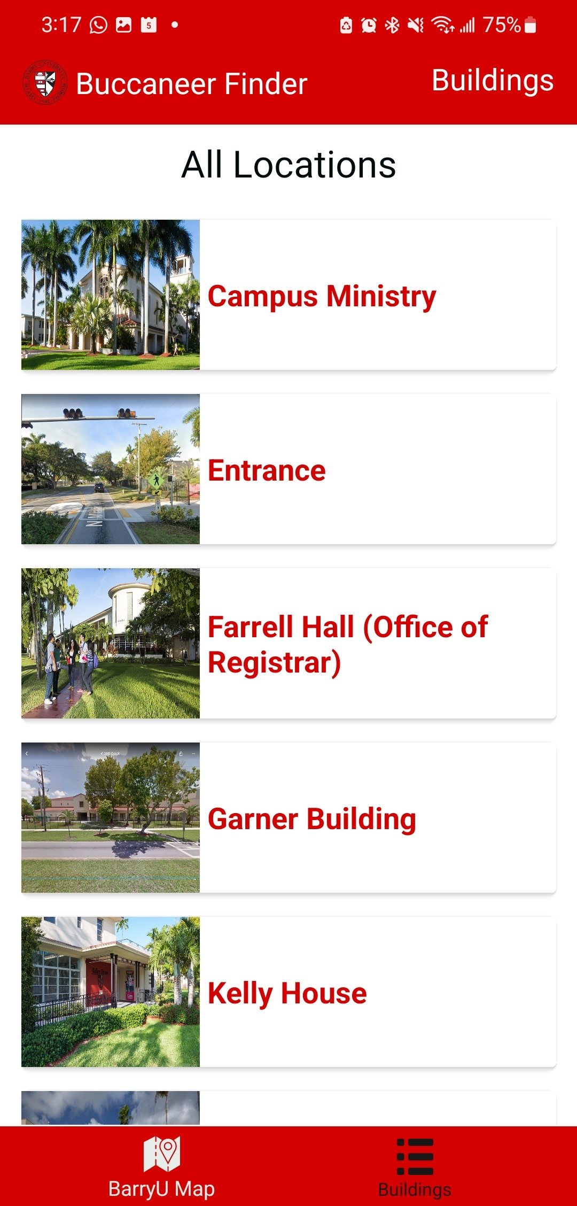
Department of Mathematics and Computer Science
Barry University
11300 NE 2nd Ave.
Miami Shores, FL 33161
Phone: (305) 899-3286
Virtual College Map – A Service Based Assistant
Luis Perez, Roger Osorio, and Dr. James Haralambides Ph.D.
Department of Mathematics and Computer Science
Barry University, Miami Shores, Florida 33161
Abstract
Materials and Methods
Results (continued)
College campuses can be large, confusing, and intimidating for new students and visitors. Finding a path to campus may be easy using a GPS unit or Google Maps directions, but this changes when you are actually on campus. There is no service that always provides a detailed map assistant within the campus itself to someone at all times. This project presents the architecture and design specifications for a campus digital assistant on a mobile device platform. We design and implement a service-focused android application for the main campus of Barry University. The map is fully interactive with customized markers and detailed information for each building including classrooms, offices, services, and contacts. This project is an upgrade of an earlier prototype. It has added or refactored features that make it easier to locate resources, map services to buildings, and automate the communication process to contact points. There are several factors that must be considered when creating the Barry University map application, such as development methods, platforms, programming languages, userbase, and cost. However, through the use of Google Map technology, a Java development environment, and the Android platform, this mobile app explores the underlying university structure, classifies and organizes services offered, facilitates keyword-based searches, and makes navigation easier and user-friendly for parents, visitors, and students using mobile devices. An embedded user guide increases system usability. The application has been implemented on the Android Studio Integrated Development Environment and was deployed and tested on a smart phone.
The “Barry Finder” app starts off with the Barry University logo and transitions to the Google Map with images of a few buildings. The images are from another map of Barry that comes with label and an outline of the building. The map is interactive, so user can move around and zoom in and out, and the images are tappable. Once tapped, the images will display the name of the building and two options, which are whether to “Cancel” or “Get More Info.” Furthermore, the main screen has a button at the bottom label “BarryU Map” that when the user is on another screen, they can click on it, and it will take them back to the main map. The “Get More Info” button will take the user to the detailed page of that building and displays different types of information.
This information can include:
A description of the building
Contact information of reaching offices in certain buildings (emails and phone numbers)
A picture of the building.
A button that will take you to your phone app and have the contact of the main number of the office.
Also, there is a button that will take the user to YouTube and show a short video of the outside of the building.
The app also contains a sidebar that will bring the user to the building list, which contains services. Services include:
Financial Aid, Campus Tours, Transcripts Information (Kelly House)
Registration, Graduation & Diploma processing, Grade Verification (Farrell Hall)
Math Lab, Reading/Writing Center (Garner Building)
Bookstore, Safety Office, Career Service, Student Health Services, Fitness Center (Landon)
Computer Lab and Study Rooms, Laptop Kiosk, Language Center (Library)
Mail Room, Subway, Asian Kitchen, Dance Studio, Andy Gato Gallery (Thompson Hall)
And more
All of this is created through the program of Android Studio with Java programming and multiple activities that change depending the screen the user is on.
Introduction
Results
Future Implementations
In recent years, navigation technology and geographic information Systems (GIS) have become an integral part of navigating unfamiliar areas. Mobile and web applications that use navigational technology have allowed users to know their location from any place and provide assistance` about the destination. Applications like Google Maps and Apple Maps are just a few of them. Barry University has many places to help a student, visitor, or employees with any service. However, much of its information are provided through paper maps that do not provide much service or a website that only displays very little detailed information. “Ask other people around the area may get the direction but it will be very tricky when the way to the destination consist many turnings point. Another challenge was need to remember all the directory correctly.” (Fai and Audah, 2017). Web apps allow different devices for navigating different pieces of information in a page, but mobile apps are much more resource-rich because many people have access to smartphones in the current generation. We find that mapping applications that enable interactivity for some users are useful for institutions that want to improve navigation around the campus, especially for students who are always mobile interactive in a college environment.
The app can and will be further improved with some future implementations. As you can see the app is in need of a few additions and some other options in case of any issues. We plan to add many changes and details to the app, these may include:
A working help button that can contact the developers or the school in case of any issues.
The map can show directions to another building.
A menu that will display all the phone numbers of every service in the buildings.
The other buildings around campus that are currently missing in the app.
Look to implement a way to show directions when inside the building.
All these changes in addition to any more suggestions will be taken into account to improve the Buccaneer Finder.
References
https://aip.scitation.org/doi/pdf/10.1063/1.5002040

